Slide 1
Strategic Framework
Connected communities in the world’s most connected place, today and tomorrow. Working together for a more inclusive, productive, resilient and influential West London
MISSION
To lead collaboration between local authorities to enable high quality sustainable services for vulnerable people
Producing and promoting services and technology that leverage innovation, scale and collaboration so that local authorities can more effectively provide for their most vulnerable residents in social care, housing, and education
OBJECTIVE
VALUES
Collaborative
Innovative
Trustworthy
Accountable
GOALS
Transforming services to deliver
maximum value and improve quality
Shaping markets to develop capacity that meets peoples’ needs
Building local authority capabilities with data, technology, training and engagement models
GROWTH PLATFORMS
Digital Transformation
Services, Partnership & Collaboration
Data, Analytics & Insight
Key Activities
Adults
Children’s
Housing & StS
Adults DPS’ (OA and LDMH)
Maintain and strengthen multi agency partnerships (CQC, ICB, AQP)
Targeted placing events
Block contracting
Market engagement
Pan London benchmarking
Dedicated inflation management and market intervention strategies
Quality assurance
Analytics
Purchasing focus on local suppliers
Dynamic Purchasing Vehicles: IFA, Resi, & Supported Accommodation
Contract monitoring
Children’s performance returns
Management of implementation of Ofsted regulation for SiL
Children’s semi-independent living accreditation
Children’s benefit realisation & value optimisation
Pan London Framework for residential parent and child assessments
Residential workforce project
Voluntary and third sector capacity project
Retender the SiL DPVs
Children’s SEN alternative provision
Develop new leaving care accommodation option in West London
Annual SEN Fee Negotiations and analysis
Housing for Vulnerable People:
Healthier Homes
Empty Homes Coordination
Market analysis and DPS
Homelessness training
Setting the Standard:
Improving registration to 90% of providers and 70% of properties uploaded through automation
Raising the profile of the service and exploring expanding the service to other temporary accommodation types
Developing the tech and data offer for user experience and KPI information

Slide 2
Adults Business plan on a page 2024/25
THE CASE
People are living longer, with more complex conditions, and WLA boroughs are ‘older’ than average for London. We have seen 110,000 more requests for social care support in ‘21/22 than ‘15/16. The price local authorities must pay for care has increased exponentially.
Local is not just a borough’s boundaries; it extends across the sub-region. Using NWL regional partnerships to manage, shape and develop the market is key to managing the demand. It creates efficiencies and enables us to use our collective purchasing power in negotiating with the market.
THE AIMS AND BENEFITS
The single market created in West London through our purchasing trends means that working collaboratively is the most effective approach to employ in enabling a robust response to market development.
Benefits include:
Lowest average prices for residential/ nursing placements in London
Purchasing Vehicles used solely for NWL and to maximise NWL capacity
Shared quality standard for SL
Shared approach to residential/nursing quality concerns
Collective approach to fee increases on new placements
Shared model for managing fee uplifts widened to include ICB/AQP partners.
Dedicated inflation management and market intervention strategies
Block contracting opportunities
Shared data dashboard
Keeping WL spend in WL.
Better outcomes and VFM for West London residents
RLW – monitoring compliance
Collective influence
Shared approaches to market shaping, development and engagement
THE ACTIVITIES
Adults DPS’ (OA and LDMH) | Maintain and strengthen multi agency partnerships (CQC, ICB, AQP) | Targeted placing events | Block contracting | Market engagement
Pan London benchmarking | Dedicated inflation management and market intervention strategies | Quality assurance | Analytics | Purchasing focus on local suppliers
THE RESOURCES
1 FT Programme Lead
0.3 Head of CA
0.5 Contracts and Procurement Officer
0.2 Commissioner

Slide 3
Children’s Business plan on a page 2024/25
THE CASE
West London continues to have significant challenges in the placing of children in good quality, appropriate and local placements at a reasonable cost that lead to the best outcomes.
The children’s programme is tackling the following challenges
The complex market of supply and demand which crosses borough boundaries
Substantial gaps in the social care workforce
Market insufficiencies and failures which exacerbate inequalities for our most vulnerable children
Quality of provision and value for money
There is not one solution that can deliver the above. The children’s programme includes several workstreams, some of which are/will be delivered directly by the CA, others we are heavily involved in but which are being led /delivered by others, and some the CA are using their position to directly influence.
THE AIMS AND BENEFITS
The aim: Partnership working to provide better quality care and value for money for our local authorities, and the best outcomes for the most vulnerable children.
The benefits: Collaboration, collective purchasing power and influence, to ensure:
local authorities are better able to transform services that deliver maximum value for users
local authorities are better able to achieve improvements in quality and value for money
To realise efficiencies, financial savings and cost avoidance generated by dynamic purchasing, fee-negotiations and programme activity
local authorities can manage out poor-quality provision and shape markets that have excess supply, so that markets and providers better meet the needs of children and do so locally
that an increased number of supported children can live close to home in the right, financially sustainable provision
that local authorities are provided with better data, technology, training, and provider engagement models
THE ACTIVITIES
Programmes delivered directly by Commissioning Alliance -
Dynamic Purchasing Vehicles (IFA, Residential) | Dynamic Purchasing Vehicle Supported Accommodation | Contract Monitoring | Children’s Performance Returns | Management of implementation of Ofsted regulation for SiL
Children’s semi-independent living accreditation | Children’s benefit realisation & value optimisation | Pan London Framework for residential parent and child assessments | Residential workforce project | Voluntary and third sector capacity project
Retender the SiL DPVs | Children’s SEN alternative provision | Develop new leaving care accommodation option in WL | Annual SEN Fee Negotiations and analysis | Identifying/co-ordinating collaborative grant funding opportunities
Programmes delivered by LAs in partnership with Commissioning Alliance -
Children’s residential development in West London | Increasing the recruitment and retention of local foster carers | Collaborative commissioning
THE RESOURCES
1x Head of Commissioning
1x Team Manager – Contract Manager
2x Commissioning Managers
2x Children’s Services Contract Managers
2x Quality Assurance Support Officers
2x Contract and Procurement Officers
0.8x SEN Service Delivery Lead

Slide 4
StS & Housing Business plan on a page 2024/25
THE CASE
London is in the grip of a housing crisis. Rents are increasing and the market is shrinking as landlords leave the market. There are over 68,000 households in TA in London. The number of families living in B&B accommodation for more than the 6-week target has doubled since 2022. West London local authorities are facing a staff recruitment and retention crisis in housing and homelessness alongside huge demand for services, increasing homelessness presentations and a squeeze on accommodation supply.
We can only address these varied and complex issues through increased partnership working and collaboration.
THE AIMS AND BENEFITS
The aims: Setting the Standard - to ensure the quality and standard of temporary accommodation in London.
Housing for vulnerable people – ensuring people are either prevented from sleeping rough or being homeless, or have received relief from homelessness.
The benefits:
Housing for vulnerable people (WL boroughs):
Reducing health inequalities by addressing damp and mould in the private rented sector
Increasing supply of TA and reducing reliance on nightly-paid and private sector, driving up standards and reducing financial pressures for LAs
Improved quality in housing stock and housing experiences for clients
Expand the training programmes run by WLA for the boroughs’ homelessness staff
Reduce pressure on recruitment for EHOs and StS inspectors by developing an apprenticeship programme
Setting the Standard (Pan-London boroughs):
Quality assurance to ensure that vulnerable people placed in nightly paid temporary accommodation have safe and decent accommodation and that local authorities’ duty of care is satisfied
Ensure that the highest risk HMO (House of Multiple Occupancy) type accommodation is regularly inspected and meets agreed safety standards
The IBAA (Inter Borough Accommodation Agreement) helps boroughs manage the TA market and provides transparency and consistency for cross borough placements
THE ACTIVITIES
Setting the Standard -
Setting the Standard | Improving registration to 90% of providers and 70% of properties uploaded through automation | Raising the profile of the service and exploring expanding the service to other TA types | Developing the tech and data offer for user experience and KPI information
Housing for Vulnerable People -
Healthier Homes | Recruit a dedicated resource for project delivery, engage 40 groups and support 500 households | Deliver a web resource and training for voluntary organisations | Ensure best practice advice and guidance to tenants and councils
Empty Homes Co-ordination | Establish a Community of Practice for EHOs | Fund and recruit a co-ordinator role to support strategic delivery | Explore funding models for Empty Homes
Market analysis and DPS | Establish a West London DPS for TA placements | Commission a framework tool for leasing/purchase agreement assessment | Benchmark appetite for acquisitions in West London
Homelessness training | Continue to deliver excellent value training in West London | Support recruitment challenges in homelessness | Expand the offer to include softer skills around resilience
THE RESOURCES
Housing:
1x Head of Housing & StS
1x Housing Programme officer (funded)
1x Homelessness Coordinator (tbc, funded)
StS Team:
1x Senior Inspections Officer
1x Market Development Manager
5.6 Inspectors (one in recruitment)
1x StS Co-ordinator
1x Assistant Co-ordinator

Slide 5
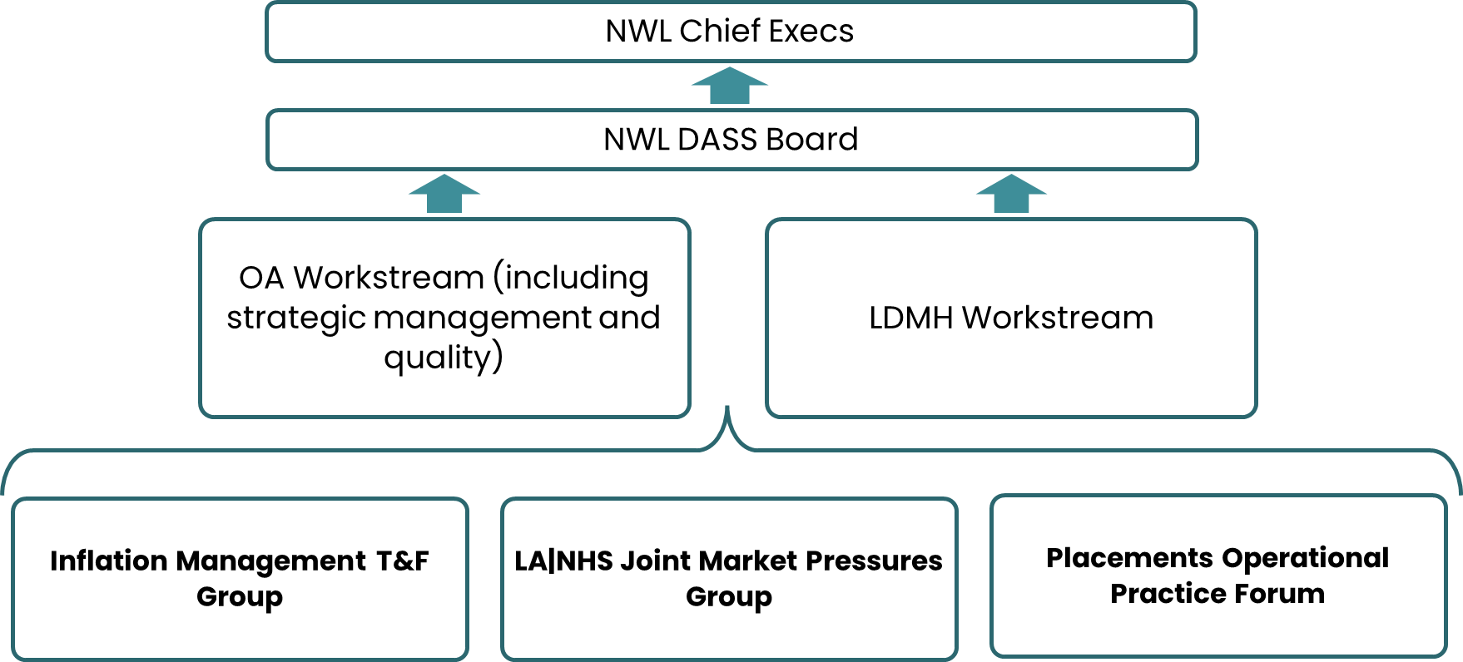
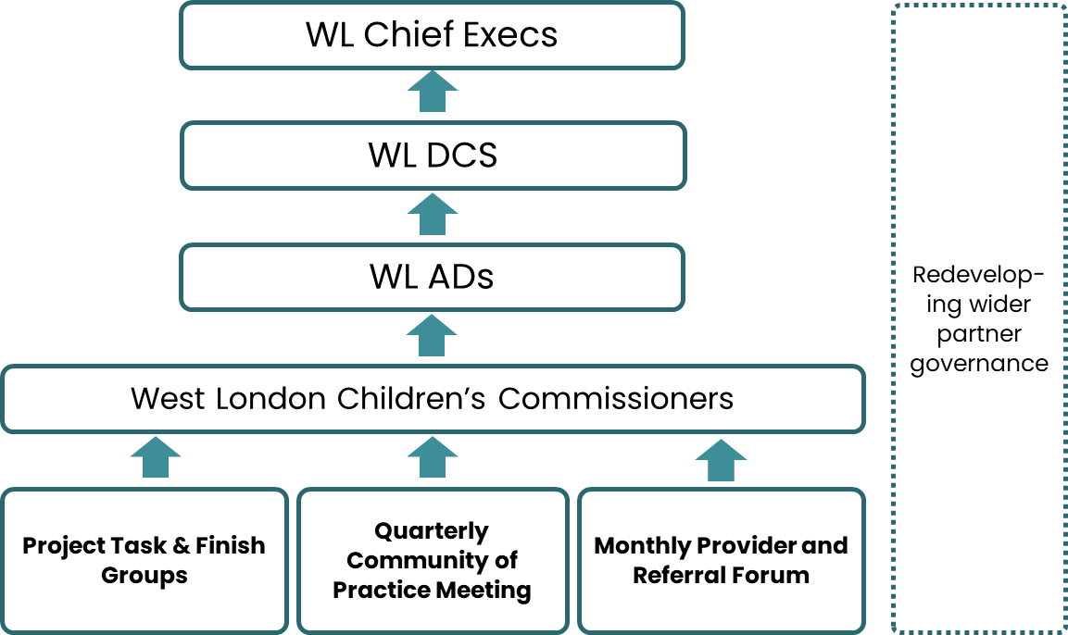
THE GOVERNANCE
Adults
Children’s
Housing for Vulnerable People
Setting the Standard

